Slide 1
Volunteer Management System
Presented by
Team SE18-08S
SE18-T08S - Jan 2012

Slide 2
Agenda
Project Revisit
High Level Architecture
System Detailed Design
Development Process
Quality Management Process
Demo – VMS v1.0
End Project Report
Q & A

Slide 3
Project Revisit
VMS - Volunteer Management System : web-based solution to facilitate the volunteer & project management process for non-government organization.
Requirement overview:
Volunteer Management
Project Management
Certificate Management
Administration

Slide 4
Agenda
Project Revisit
High Level Architecture
System Detailed Design
Development Process
Quality Management Process
Demo – VMS v1.0
End Project Report
Q & A

Slide 5
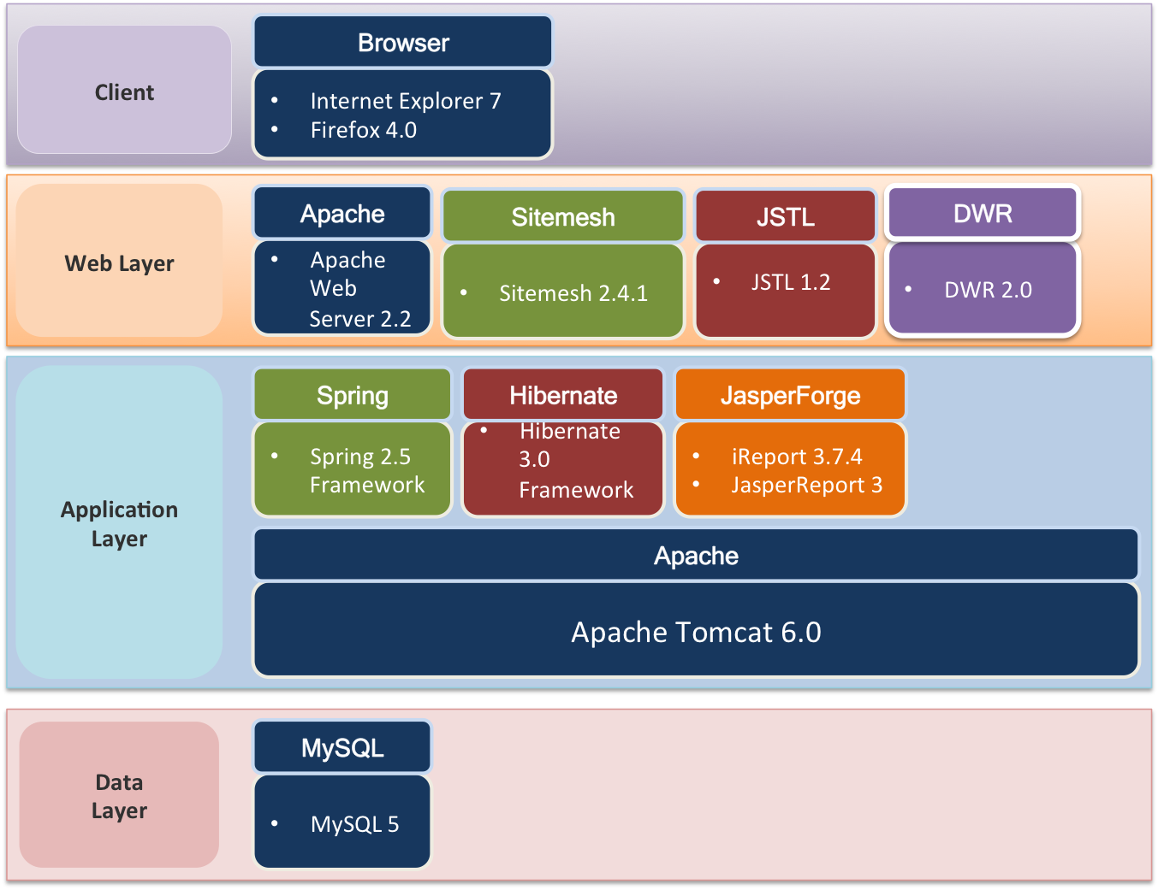
High Level Architecture - 1 System components

Slide 6
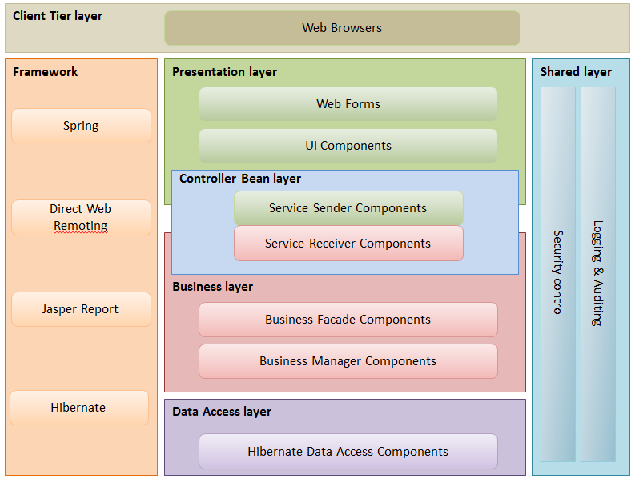
High Level Architecture - 2 Logical Application Architecture

Slide 7
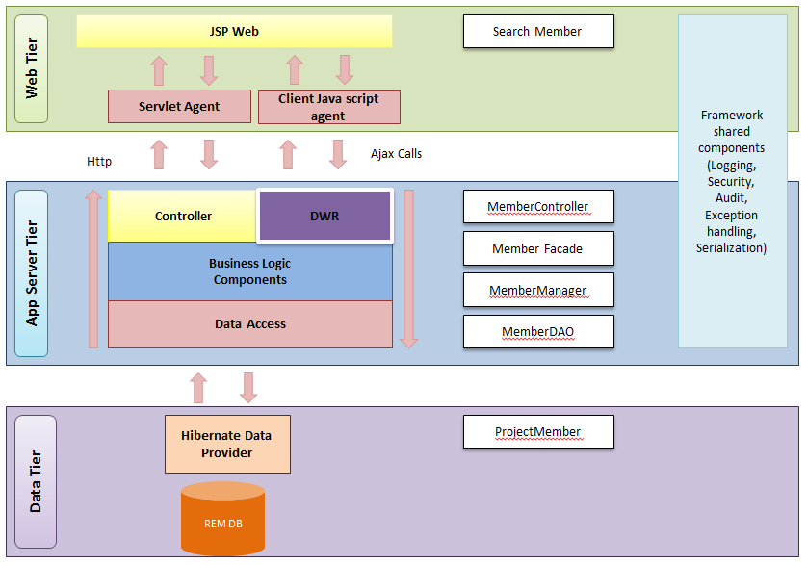
High Level Architecture - 3 Logical Application Sample

Slide 8
Agenda
Project Revisit
High Level Architecture
System Detailed Design
Development Process
Quality Management Process
Demo – VMS v1.0
End Project Report
Q & A

Slide 9
System Detailed Design - 1
Design Consideration:
Application layer: Spring Framework / DWR
Security
Service / Façade
Interface - Implementation
Data access layer: Hibernate Framework
UI layer: jQuery & Plugins
Utility components: log4J / JasperReport

Slide 10
System Detailed Design - 2
UCRR (Design):
Register Volunteer Account
<<UCRR design>>
Generate Certificate
<<UCRR design>>

Slide 11
Agenda
Project Revisit
High Level Architecture
System Detailed Design
Development Process
Quality Management Process
Demo – VMS v1.0
End Project Report
Q & A

Slide 12

Development Process - 1
Development cycle:
Detailed Design
Code implementation
Test / QA
Fix / improvement
Check-in

Slide 13
Development Process - 2
Build order:
Base manager / base services
Security / Logging / Validation / Common utility
Master data management
Use case logic / transaction management
UI development (JSP) + UI validation

Slide 14

Development Process - 3
Software Configuration Management:
SVN Repository:
Code Check-in / Check-out / Merge
Database rollout / backup
Deployment server backup to disk
Quality Management:
Perspective review
Code walk-through
Peer review (design / code)
Unit test

Slide 15


Development Process - 4
Challenges 1 : Development of inter-dependent modules:
Volunteer Management
Project Management
Infrastructure Utilities (email, logging, Access Control)
Solution:
Define tasks dependency network
Split into parallel developments:
Non-dependent components
Prioritized components
Daily code merge / code compare

Slide 16
Development Process - 5
Challenges 2 : Changes in user requirements:
De-scoped use cases
New user requirements
Solution:
Prioritize and validate user requirements
User requirements review
Analysis review
Design review

Slide 17
Agenda
Project Revisit
High Level Architecture
System Detailed Design
Development Process
Quality Management Process
Demo – VMS v1.0
End Project Report
Q & A

Slide 18
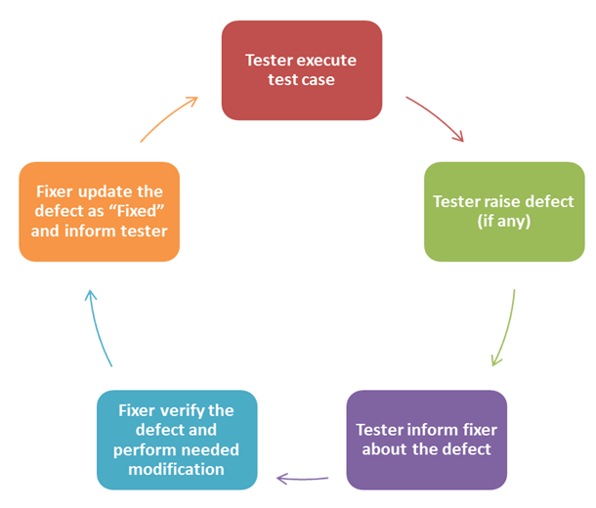
Quality Management Process - 1
Quality Assurance process
URS → Design test cases → Test activities
Test cycle:

Slide 19
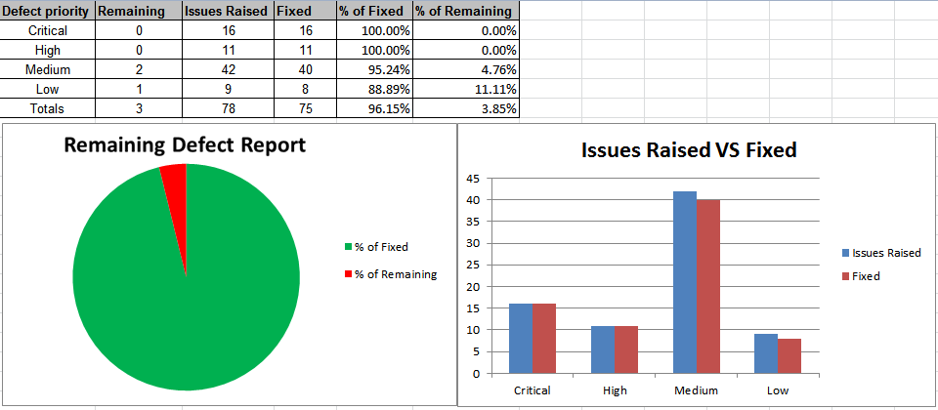
Quality Management Process - 2
Test results:

Slide 20
Agenda
Project Revisit
High Level Architecture
System Detailed Design
Development Process
Quality Management Process
Demo – VMS v1.0
End Project Report
Q & A

Slide 21
Demo of Prototype
Demo Use Cases:
Register Volunteer Account
Propose Project to Organization
Request to Join Project
Manage Project Role
Give Feedback To Project
Request for Project Certificate

Slide 22
Demo of Prototype
Video

Slide 23
Agenda
Project Revisit
High Level Architecture
System Detailed Design
Development Process
Quality Management Process
Demo – VMS v1.0
End Project Report
Q & A

Slide 24
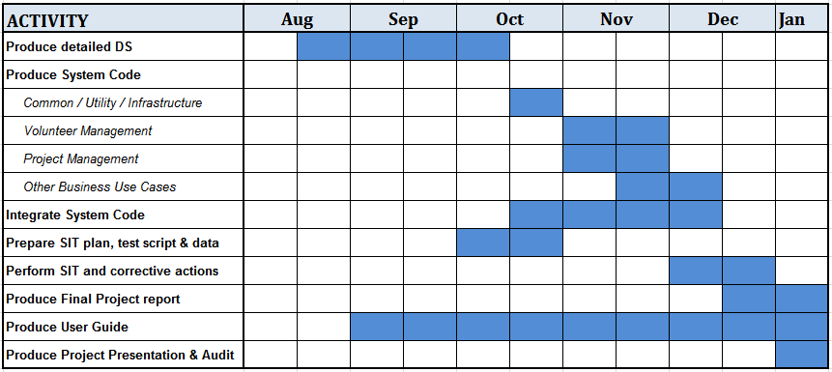
End Project Report
Notes:
Project Plan was reviewed and update mid-way to reflect current progress.
User requirements are reviewed and updated

Slide 25
Agenda
Project Revisit
High Level Architecture
System Detailed Design
Development Process
Quality Management Process
Demo – VMS v1.0
End Project Report
Q & A

Slide 26
Question & Answer

Slide 27
Thank you for a great year !!!
SE18 Team 08S
--------------------
Hnin Nu Aye, Hazel Sr. Business Analyst
Feng Yan Development Lead
Jiang Jifa Test Manager
Liu Peishan Quality Manager
Phung Kim Cuong, Dio Project Manager
Thida Khin Myo Thaung Business Analyst Lead
Zaw Htet Technical Lead

